Slide 1
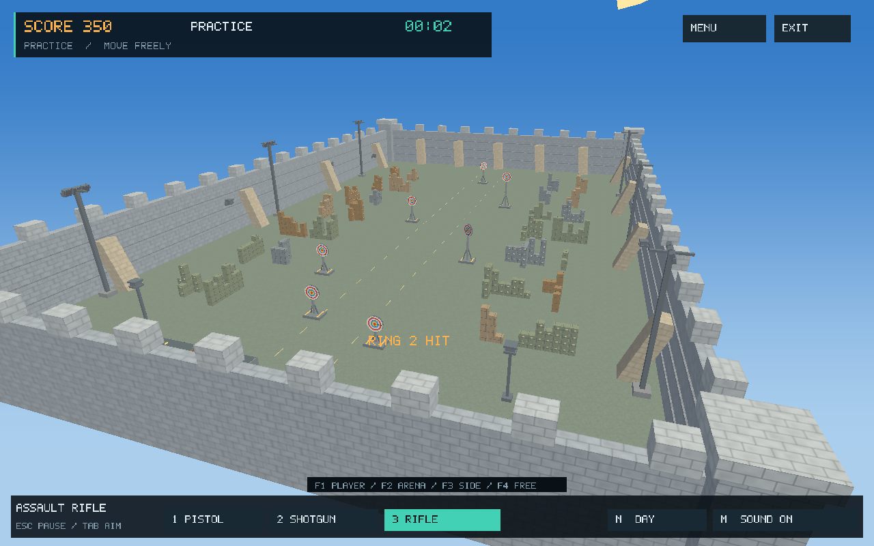
COMPUTER GRAPHICS PROJECT
3D Target Shooter
Kazi Rifat Al Muin • 2107042 • CSE 4102 • KUET
3D TARGET SHOOTER / CSE 4102
01 / 16
Notes:
Project sources: report/report.tex; README.md

Slide 2
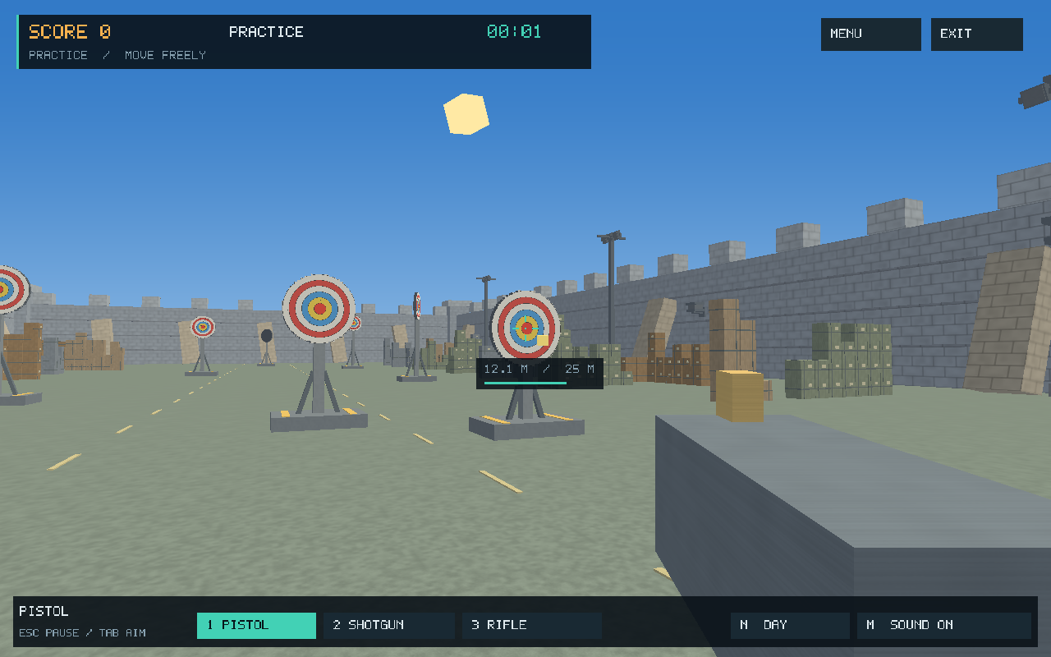
INTRODUCTION
The completed project
Player view — aiming, targets and HUD
Arena view — walls, cover and firing lanes
Cube-based modelling • transformations • animation • lighting • interaction
3D TARGET SHOOTER / CSE 4102
02 / 16
Notes:
Project sources: report/report-sections.tex, Sections 1–2

Slide 3
GAMEPLAY AND LEVEL DESIGN
All seven Challenge levels
Level | Targets | Walking | Motion / cover | NPCs
1 | 3 | Locked | Stationary targets | None
2 | 3 | Locked | Centre target moves horizontally | None
3 | 4 | Locked | Separate X, Y and Z motion | None
4 | 6 | Enabled | Cargo cover, longer range and rotation | None
5 | 8 | Enabled | Compound target trajectories | 8 birds
6 | 10 | Enabled | Faster three-axis trajectories | 16 birds
7 | 12 | Enabled | Final pair: faster motion and spin | 48 birds; 36 humans
46 targets across seven levels; movement unlocks from Level 4.
3D TARGET SHOOTER / CSE 4102
03 / 16
Notes:
Project sources: report/report-sections.tex, Section 2.2

Slide 4
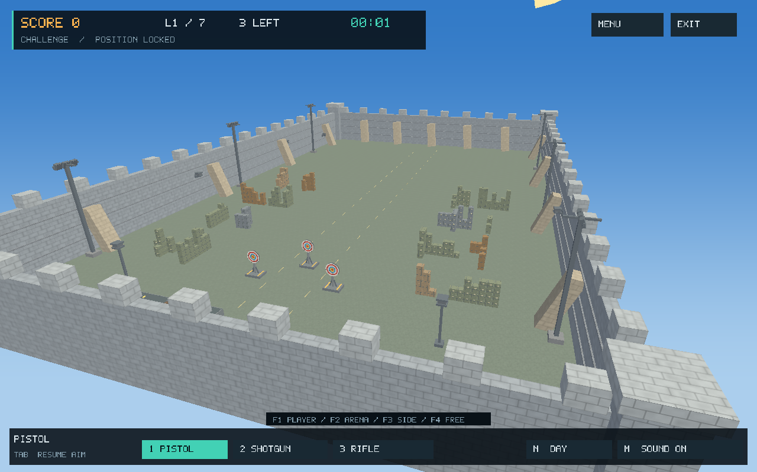


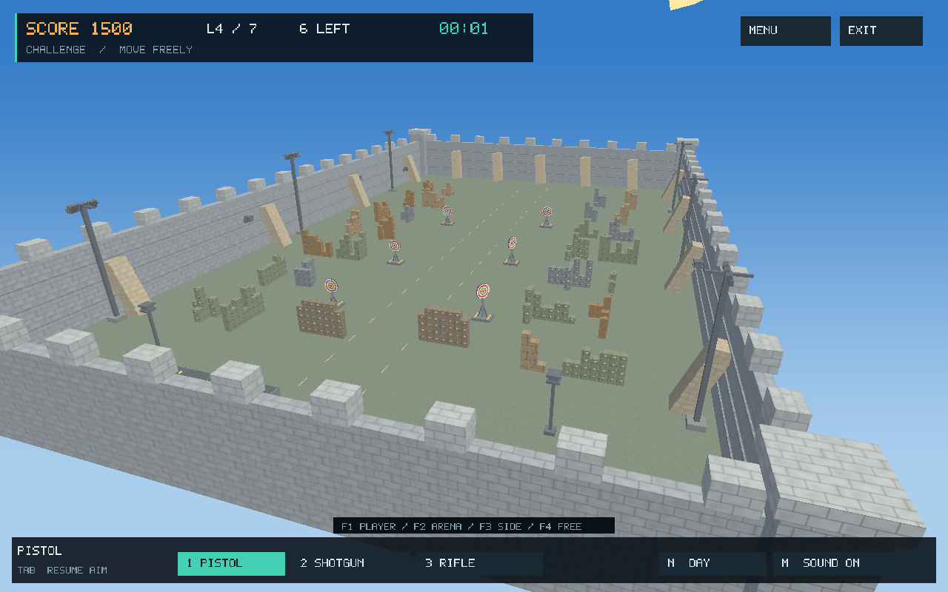


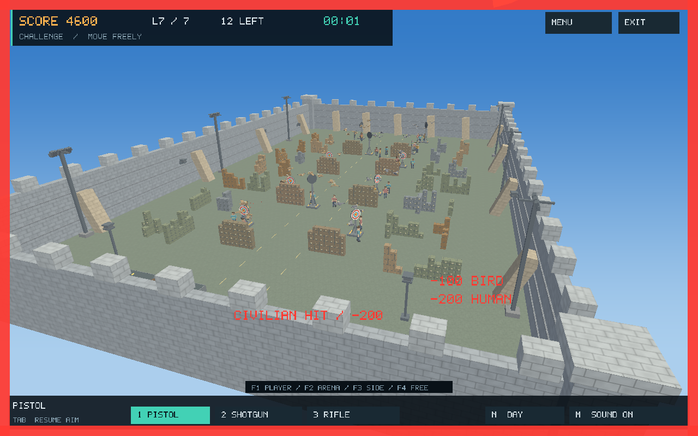
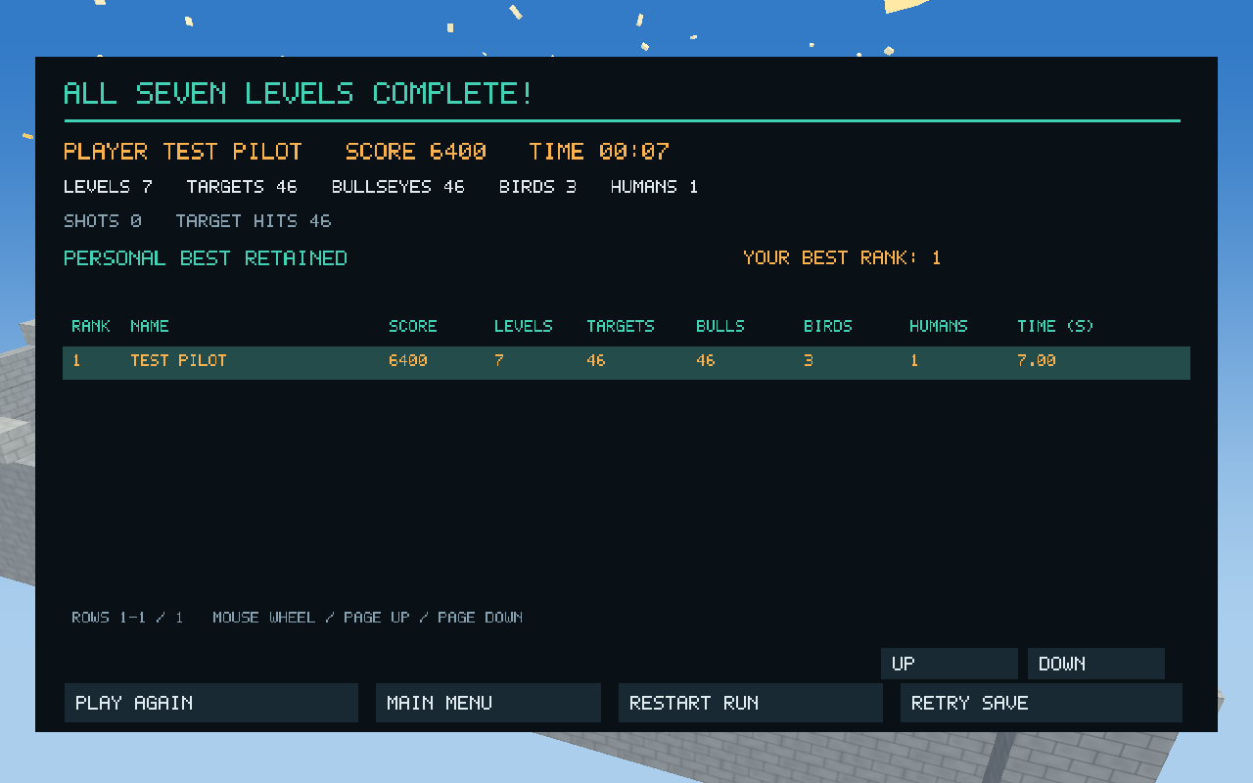
GAMEPLAY AND LEVEL DESIGN
Seven levels in pictures
1 Stationary
2 Horizontal motion
3 Separate motion axes
4 Cover + rotation
5 Compound motion + birds
6 Faster motion
7 Birds + humans
Final-level results
3D TARGET SHOOTER / CSE 4102
04 / 16
Notes:
Project sources: docs/images/release-level-1.png through release-level-7.png

Slide 5
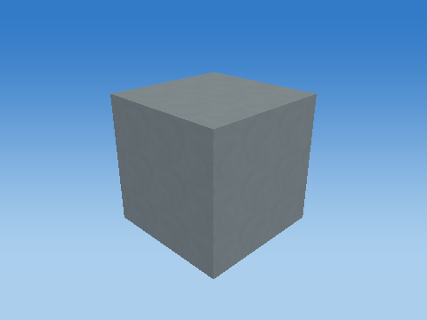
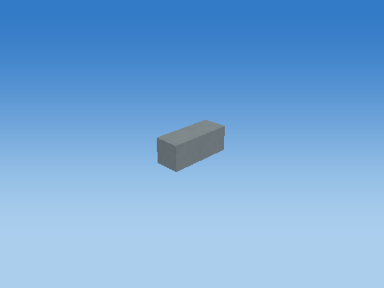
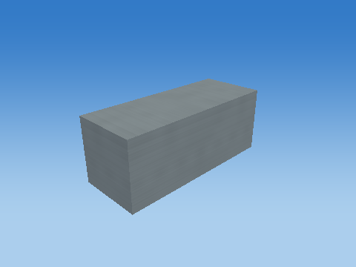
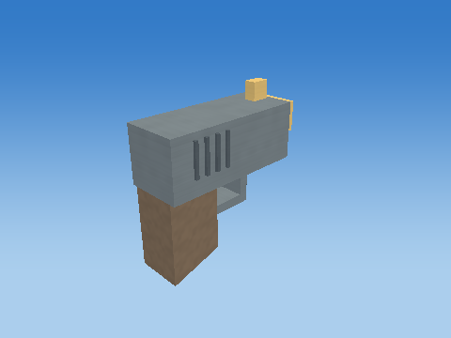
OBJECT CONSTRUCTION AND TRANSFORMATIONS
Construction: cube to finished object
Unit cube
Scaled component
Placed component
Complete pistol
M = T Rz Ry Rx H S
3D TARGET SHOOTER / CSE 4102
05 / 16
Notes:
Project sources: objects/weapon-pistol/; report/report-sections.tex, Section 3

Slide 6
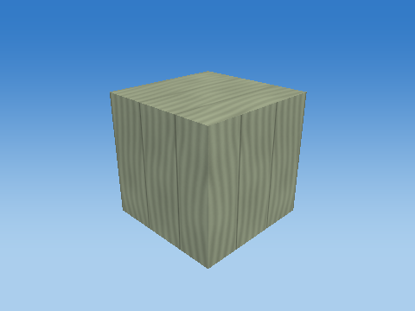
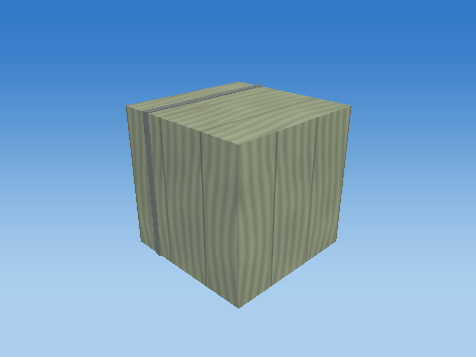

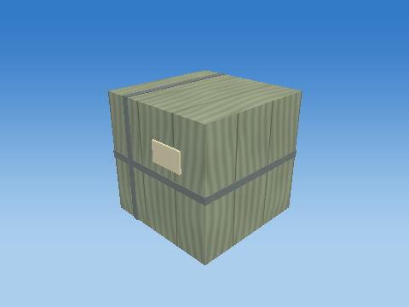
OBJECT CONSTRUCTION
Cargo crate: complete assembly
Assembly after 1 parts
Assembly after 2 parts
Assembly after 3 parts
Assembly after 4 parts
Four transformed cubes form the full crate.
3D TARGET SHOOTER / CSE 4102
06 / 16
Notes:
Project sources: objects/cargo-crate/; report/report-sections.tex, Section 3.4

Slide 7
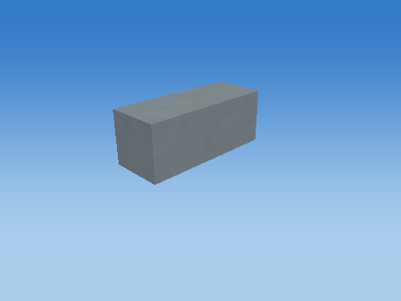
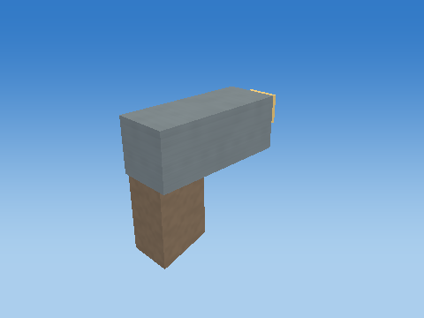



OBJECT CONSTRUCTION
Pistol: from first part to complete model
Assembly after 1 parts
Assembly after 3 parts
Assembly after 5 parts
Assembly after 7 parts
Assembly after 9 parts
11 parts — complete pistol
3D TARGET SHOOTER / CSE 4102
07 / 16
Notes:
Project sources: objects/weapon-pistol/; report/report-sections.tex, Section 3.5

Slide 8
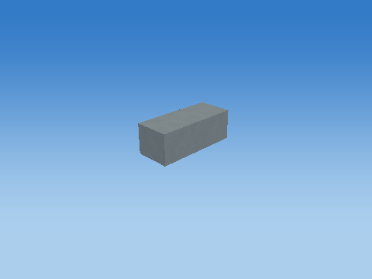
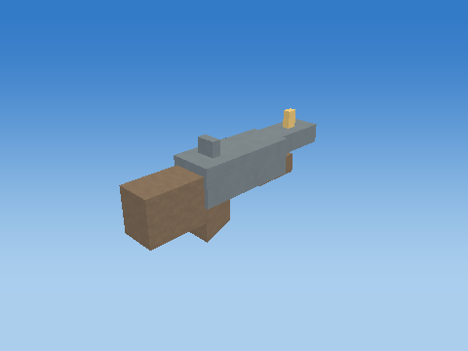
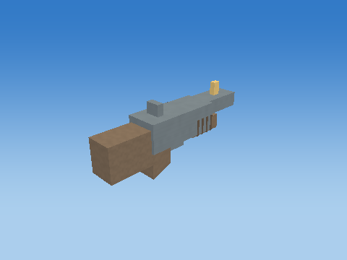
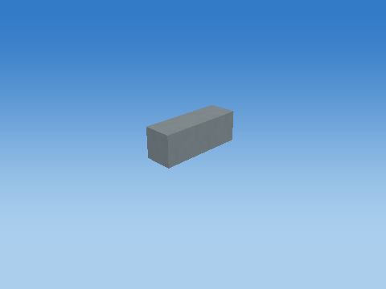
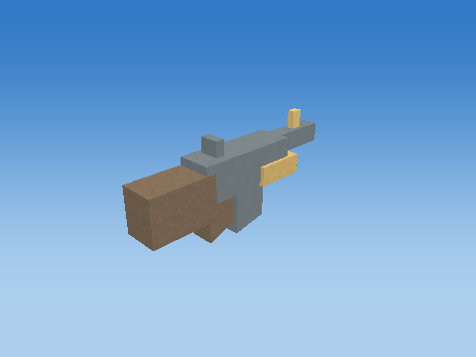
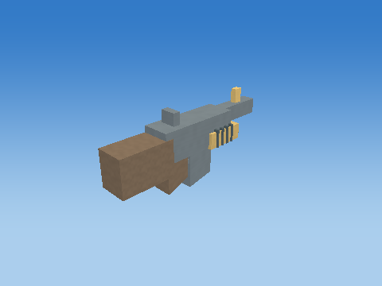
OBJECT CONSTRUCTION
Shotgun and rifle: complete assemblies
Shotgun • first part
Shotgun • 7 parts
Shotgun • complete, 14 parts
Rifle • first part
Rifle • 8 parts
Rifle • complete, 15 parts
3D TARGET SHOOTER / CSE 4102
08 / 16
Notes:
Project sources: objects/weapon-shotgun/; objects/weapon-rifle/; report/report-sections.tex, Section 3.6

Slide 9
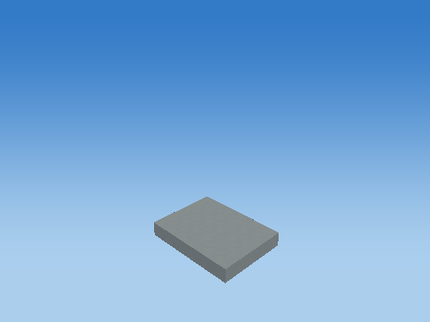
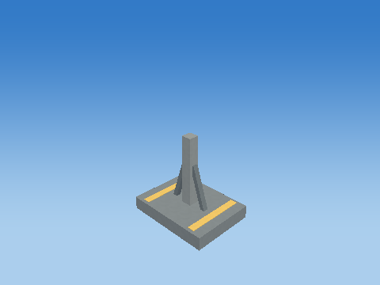
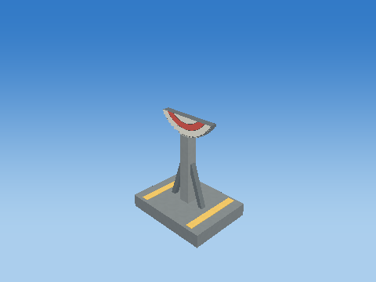
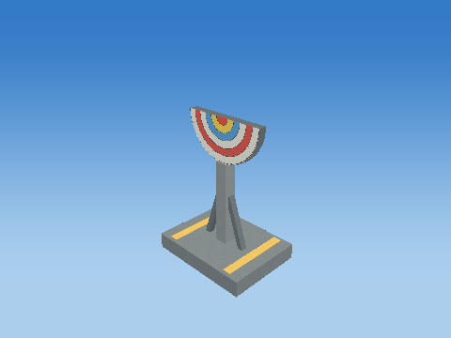
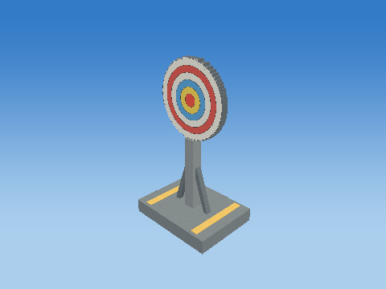
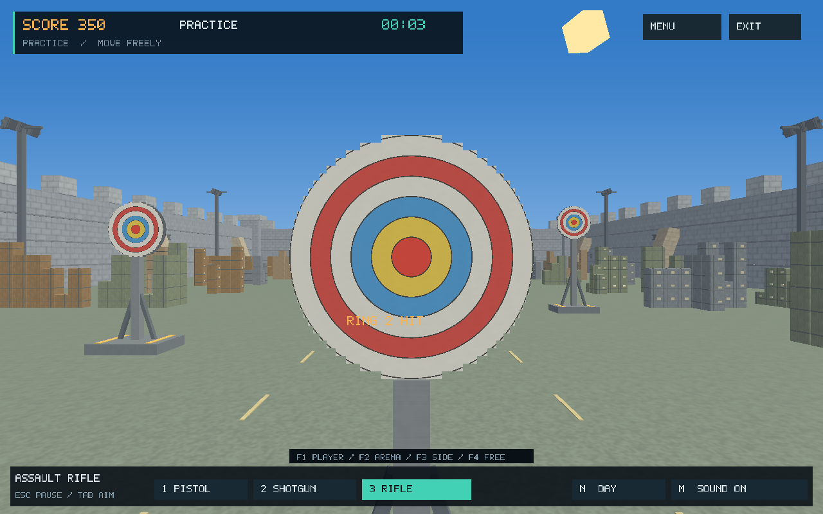
OBJECT CONSTRUCTION
Target: stand, slices and scoring rings
Base
Complete stand
First 8 plate slices
First 16 plate slices
38 parts — complete target
Six shader-generated rings
32 plate slices: width = 2√(r² − y²) • r = 0.8 m
3D TARGET SHOOTER / CSE 4102
09 / 16
Notes:
Project sources: objects/target/; report/report-sections.tex, Section 3.7

Slide 10
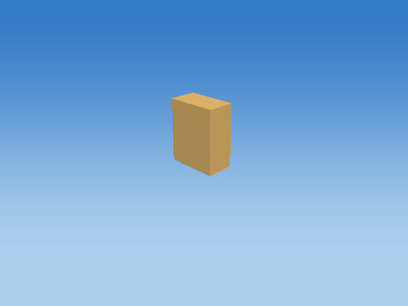
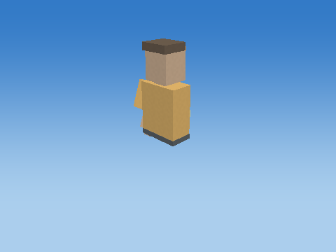
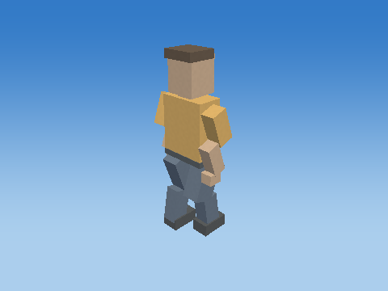
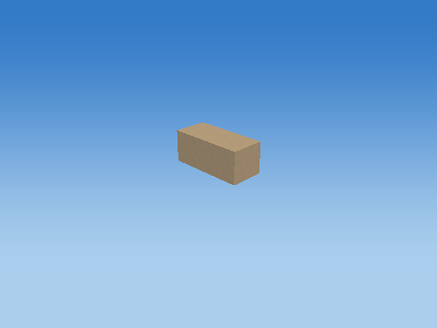
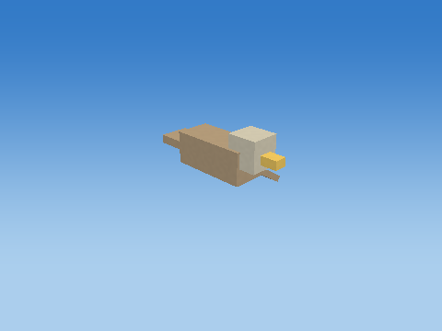
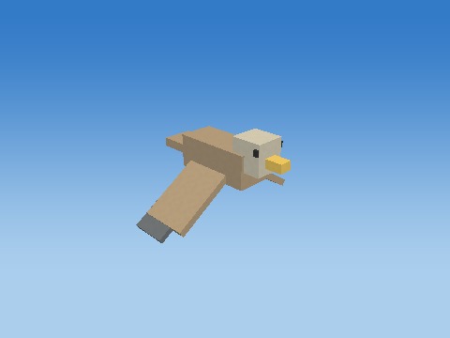
OBJECT CONSTRUCTION
Human and bird: multipart construction
Human • first part
Human • 10 parts
Human • complete, 21 cuboids
Bird • first part
Bird • 5 parts
Bird • complete, 10 cuboids
3D TARGET SHOOTER / CSE 4102
10 / 16
Notes:
Project sources: objects/human/; objects/bird/; report/report-sections.tex, Section 4.2

Slide 11
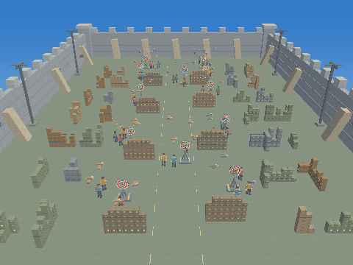
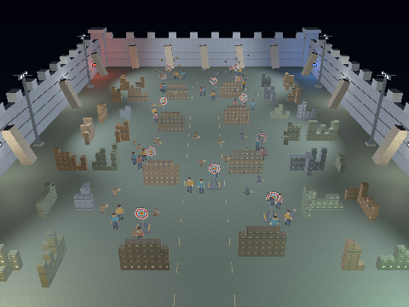
LIGHTING AND SHADING
Lighting: day and night
Day — ambient fill and directional sunlight
Night — ambient fill, 8 point lamps and 6 spotlights
Same scene and camera; different source intensities.
3D TARGET SHOOTER / CSE 4102
11 / 16
Notes:
Project sources: report/report-sections.tex, Section 7; lighting/day-2-mask-15.png; lighting/night-2-mask-15.png

Slide 12
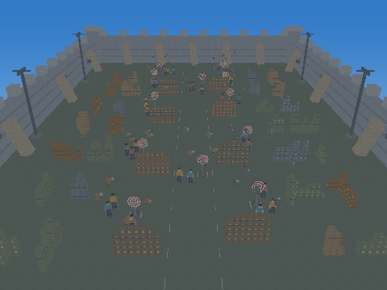
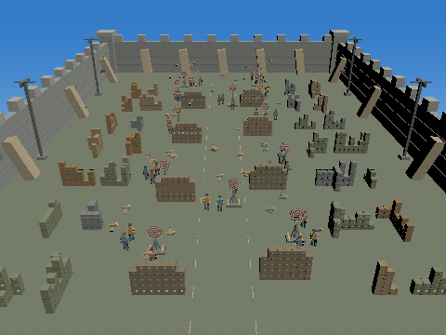
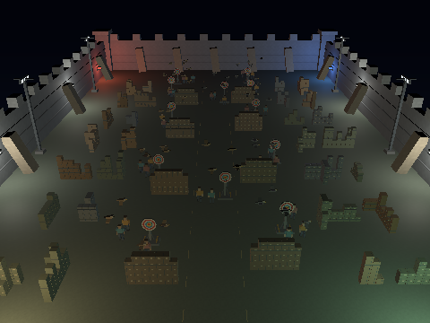
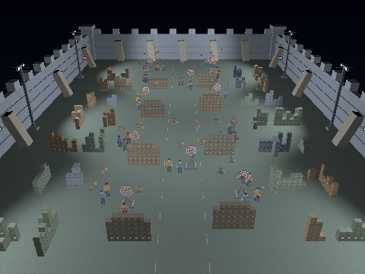
LIGHTING AND SHADING
Lighting: source-by-source comparison
Ambient — constant background fill
Directional — orientation-dependent sunlight
Point lamps — local light with distance falloff
Spotlights — focused beams with soft cone edges
3D TARGET SHOOTER / CSE 4102
12 / 16
Notes:
Project sources: report/report-sections.tex, Sections 7.1–7.2; lighting/

Slide 13
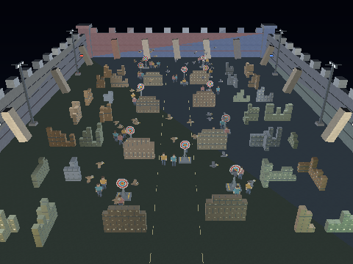
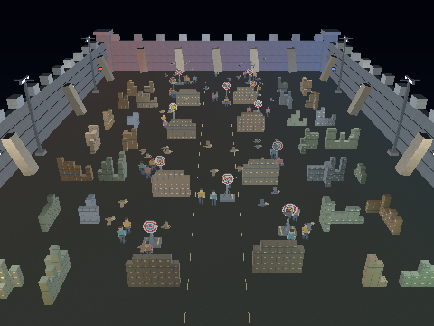
LIGHTING AND SHADING
Shading: flat, Gouraud and Phong
Flat — one lighting value per triangle
Gouraud — interpolated vertex lighting
Phong — lighting evaluated per fragment
Flat | Gouraud | Phong
Constant triangle regions | Smooth vertex-to-vertex variation | Detailed local light and highlights
3D TARGET SHOOTER / CSE 4102
13 / 16
Notes:
Project sources: report/report-sections.tex, Section 7.3; lighting/night-*-mask-15.png

Slide 14
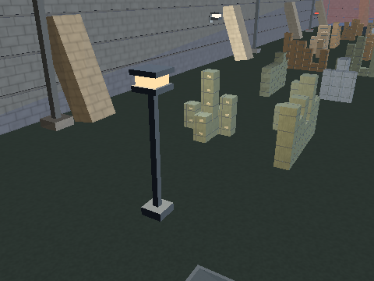
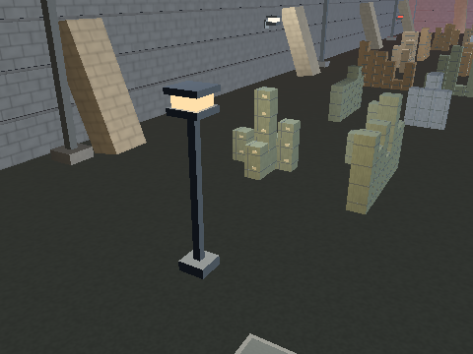
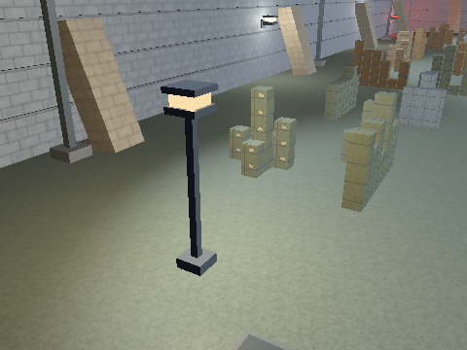
LIGHTING AND SHADING
Shading: close-up comparison
Flat — triangle boundaries are visible
Gouraud — light blends between vertices
Phong — light responds at each fragment
Same camera, geometry and lights; only the shading method changes.
Diffuse ∝ max(N · L, 0) | Specular ∝ max(R · V, 0)ⁿ
3D TARGET SHOOTER / CSE 4102
14 / 16
Notes:
Project sources: report/report-sections.tex, Section 7.3; lighting/night-*-mask-15-close.png; shaders/lighting.glsl

Slide 15
CONCLUSION
Conclusion
One reusable cube.
Complete 3D assemblies.
Seven progressive levels.
Three shading methods.
Modelling, animation and lighting combined in one interactive project.
3D TARGET SHOOTER / CSE 4102
15 / 16
Notes:
Project sources: report/report-sections.tex, Conclusion

Slide 16
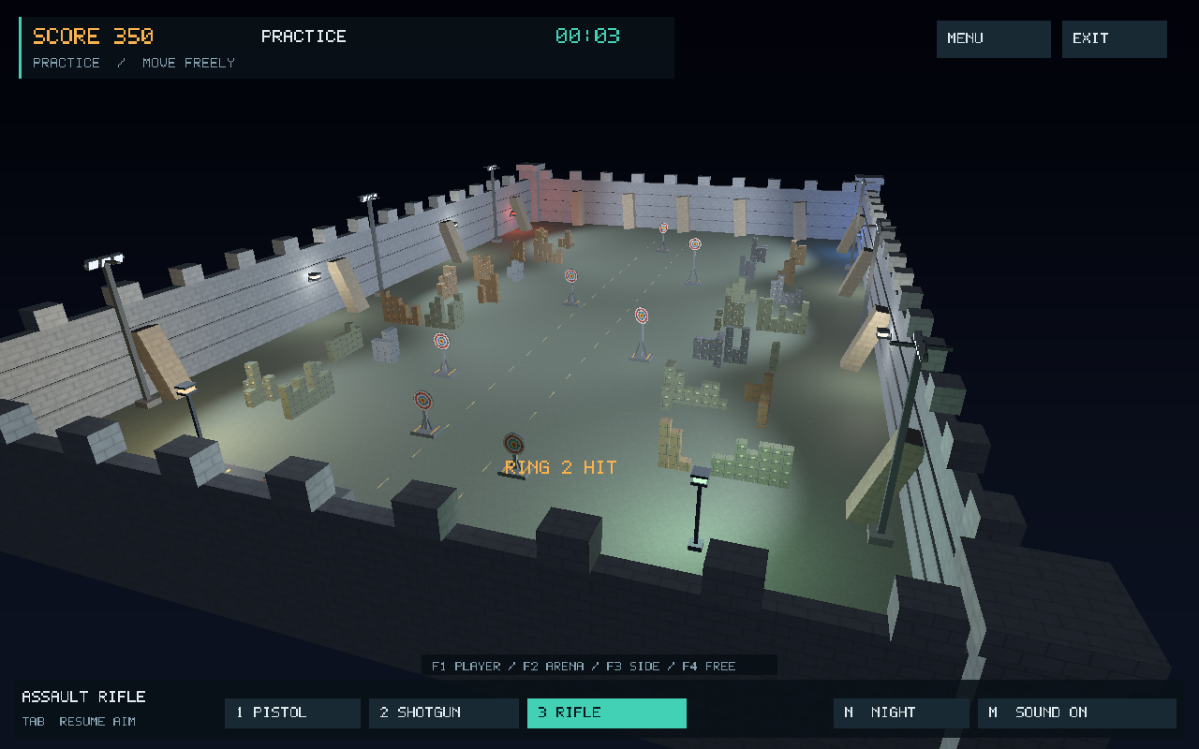
3D TARGET SHOOTER
Thank You
Kazi Rifat Al Muin • 2107042
3D TARGET SHOOTER / CSE 4102
16 / 16

